Slide 1

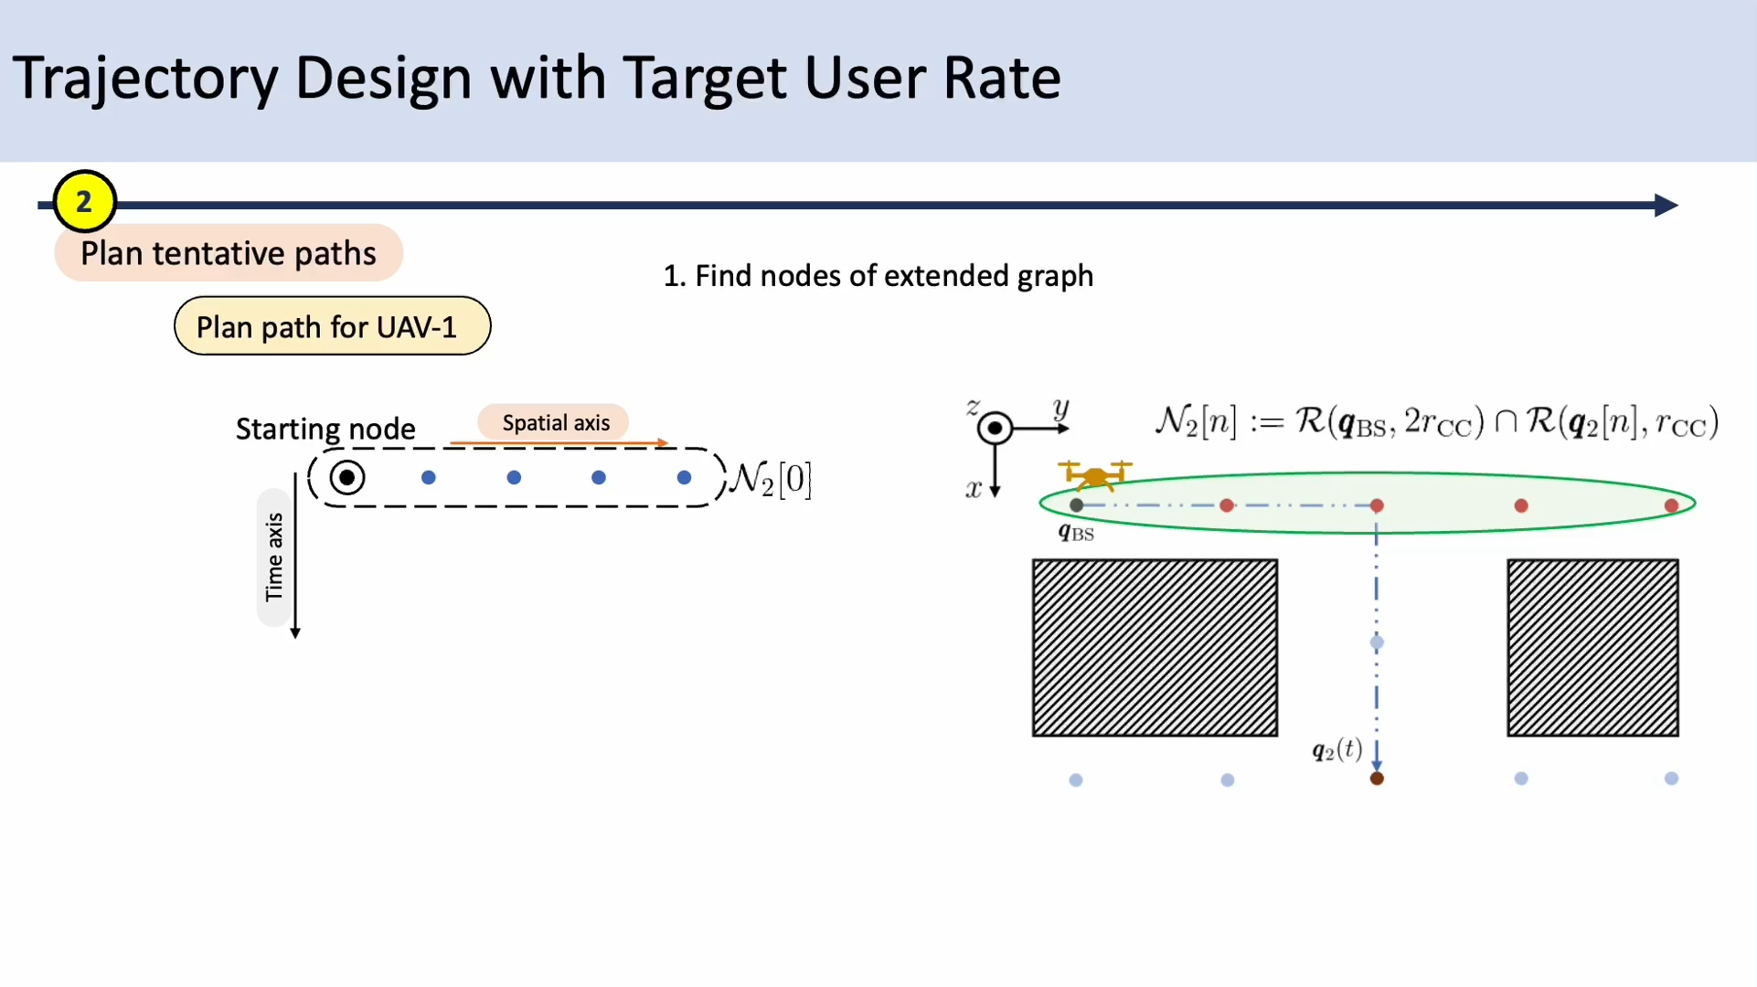
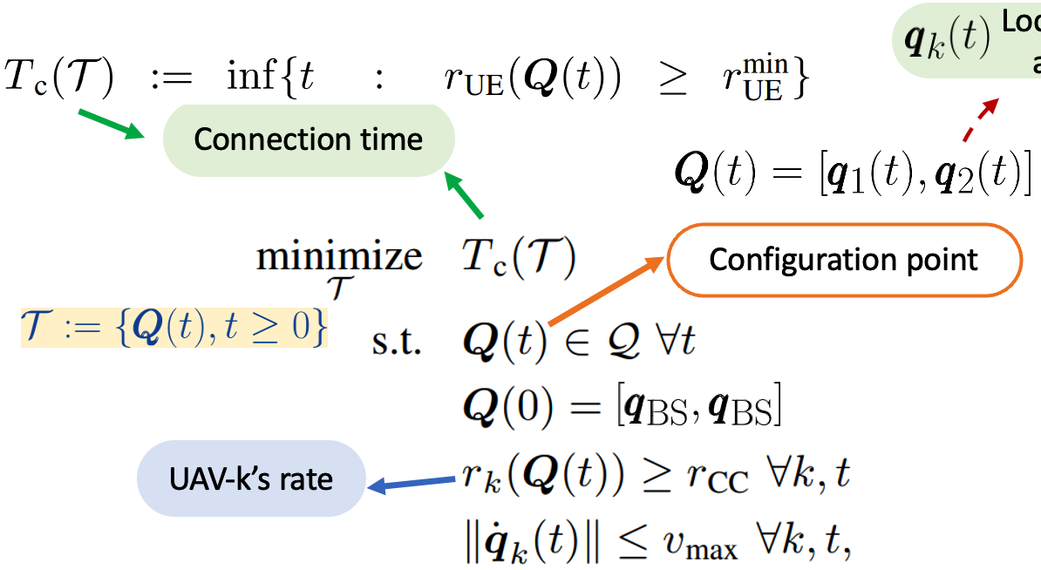
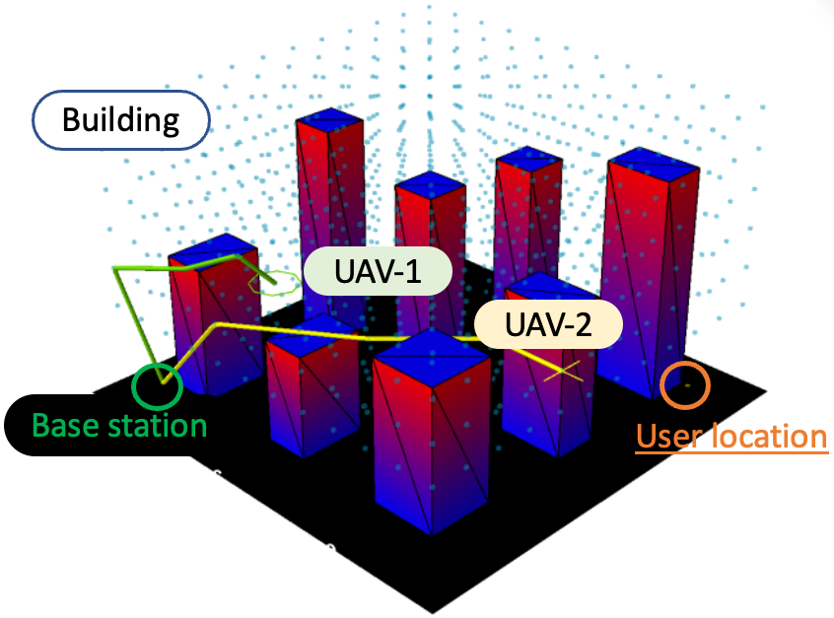
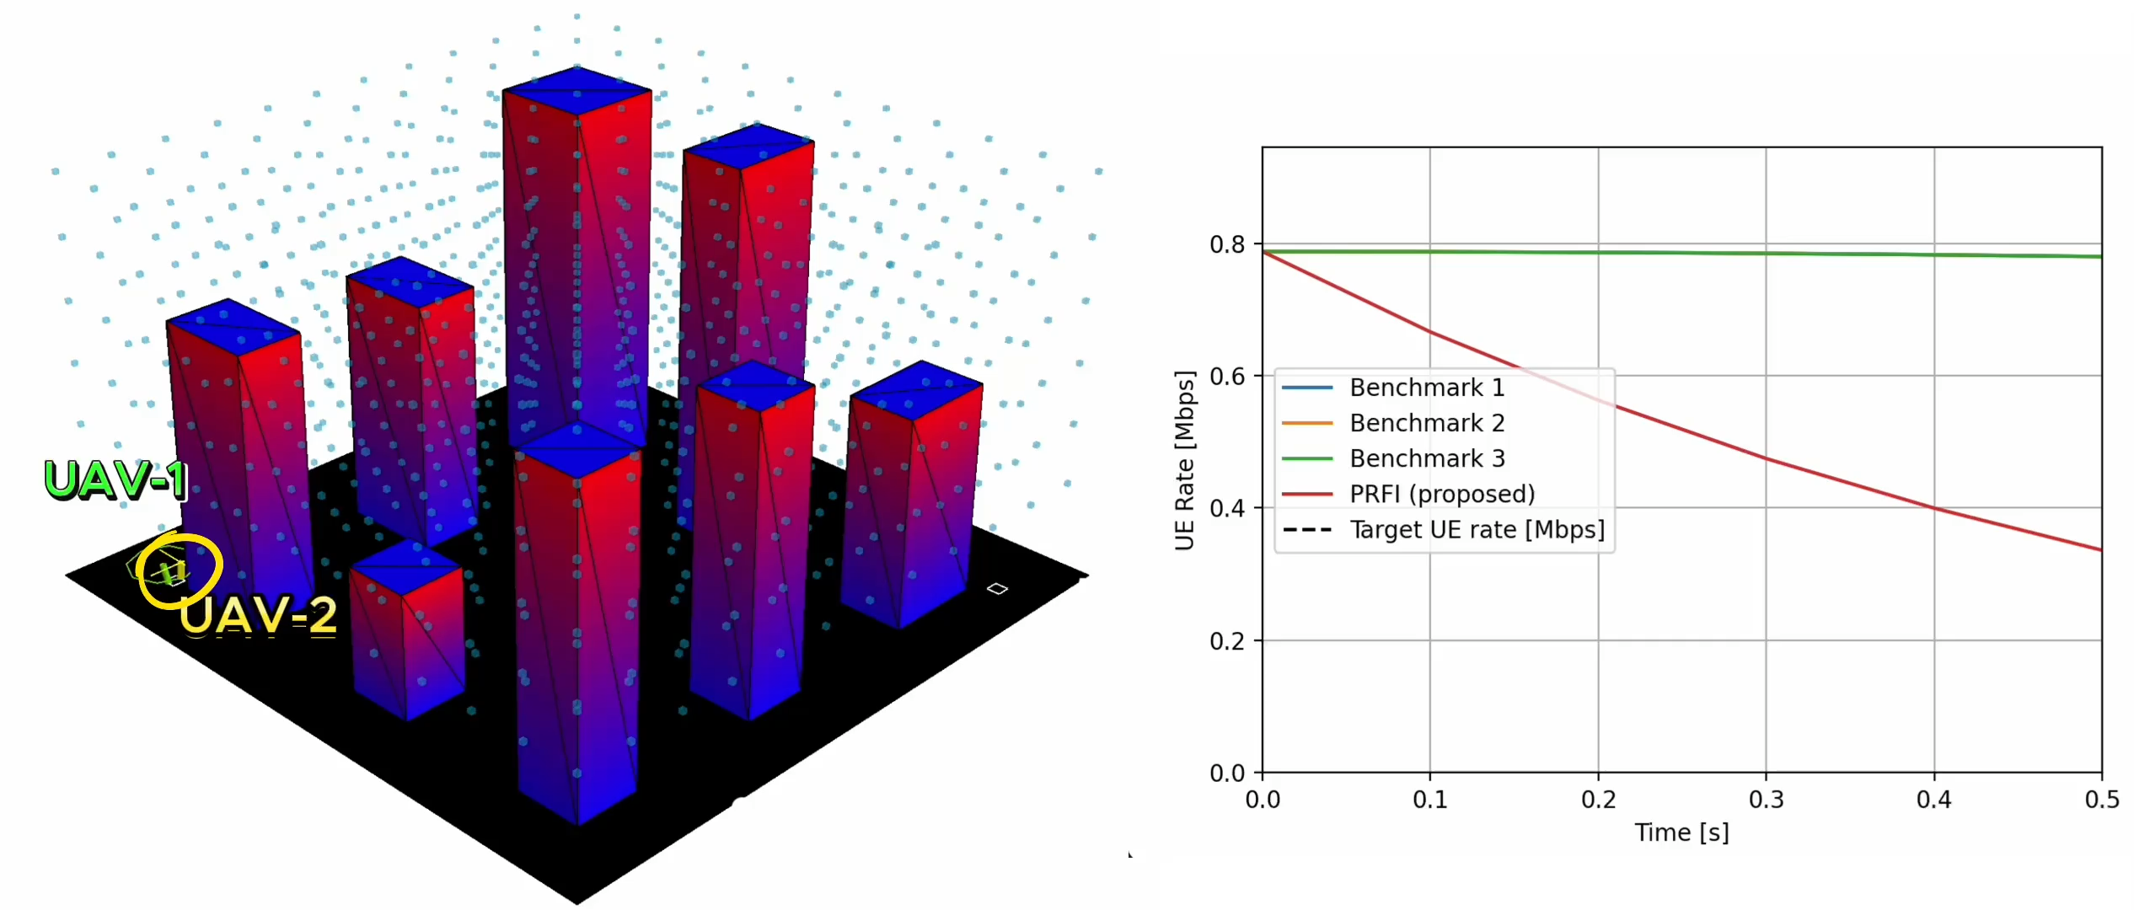
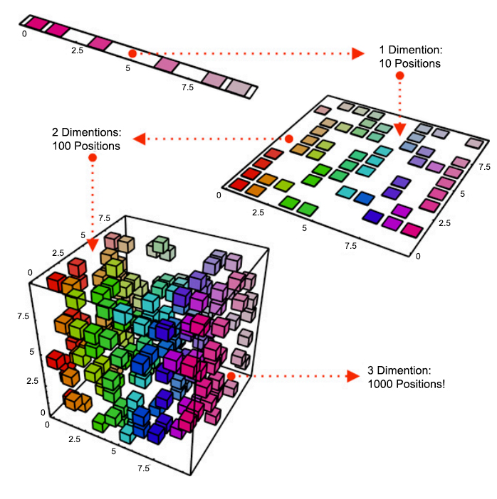




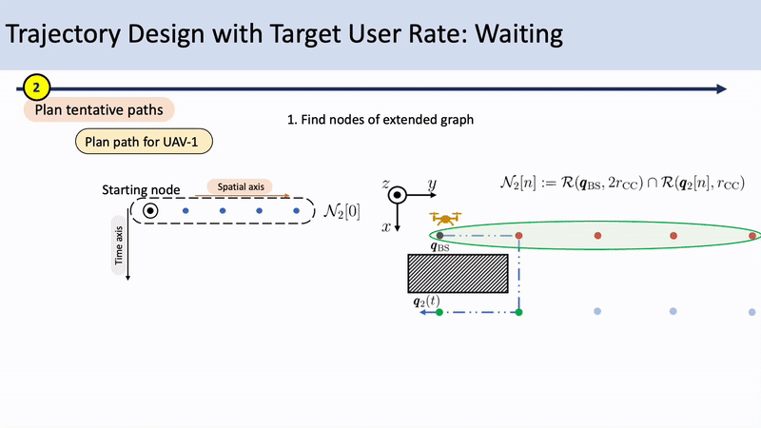
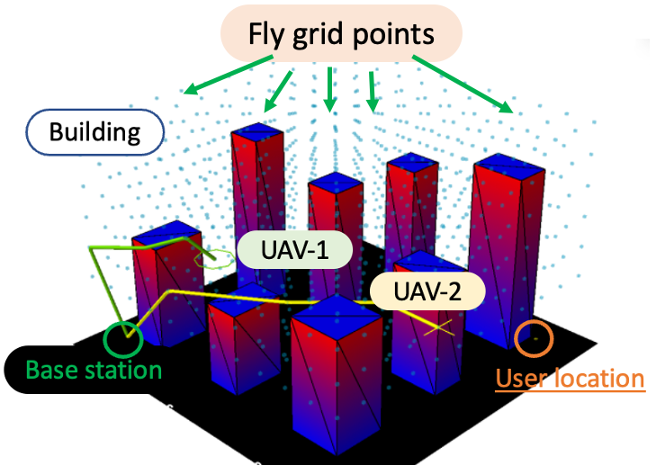


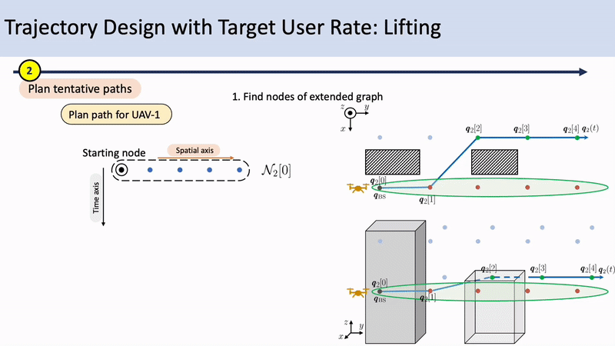

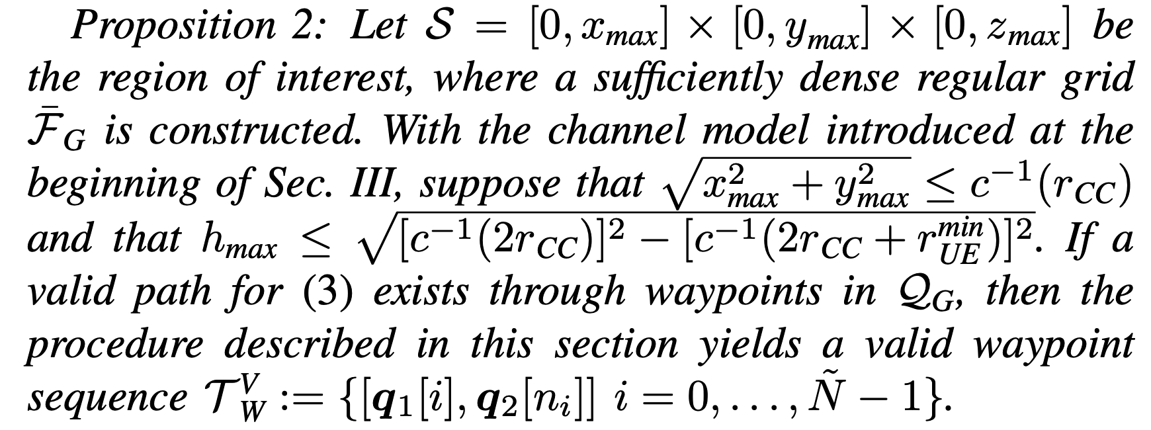




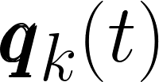


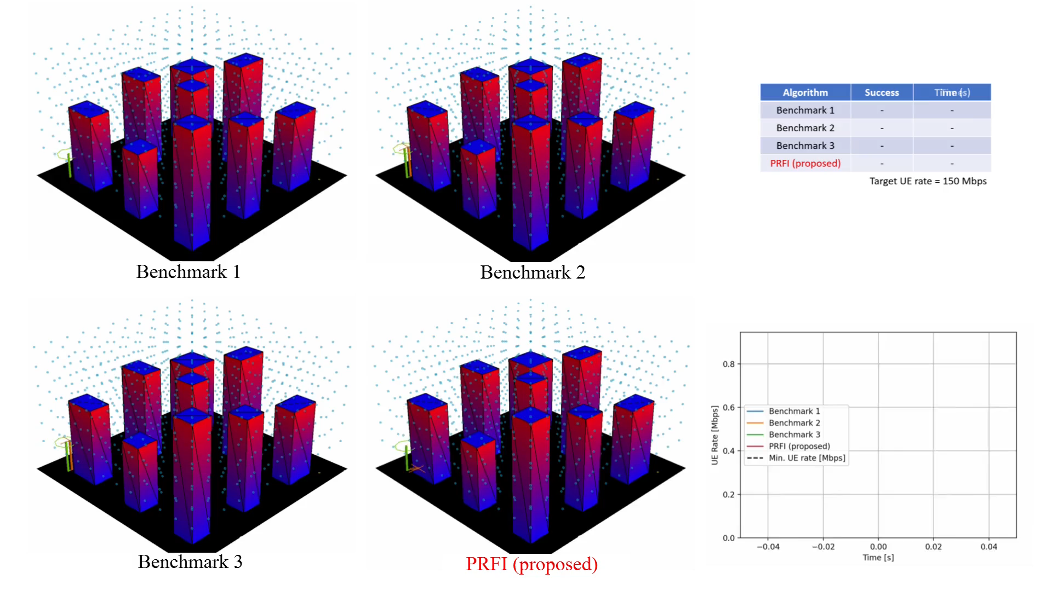
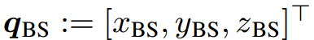
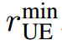
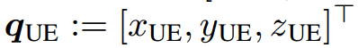
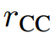
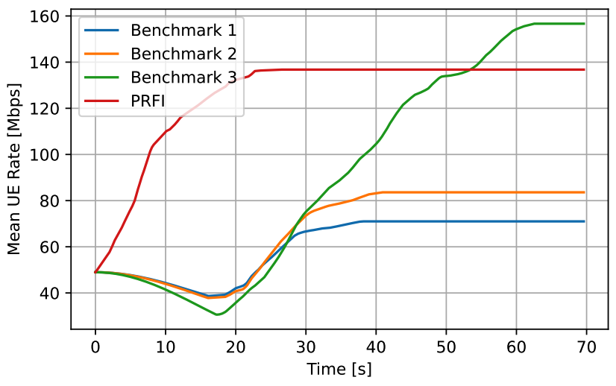
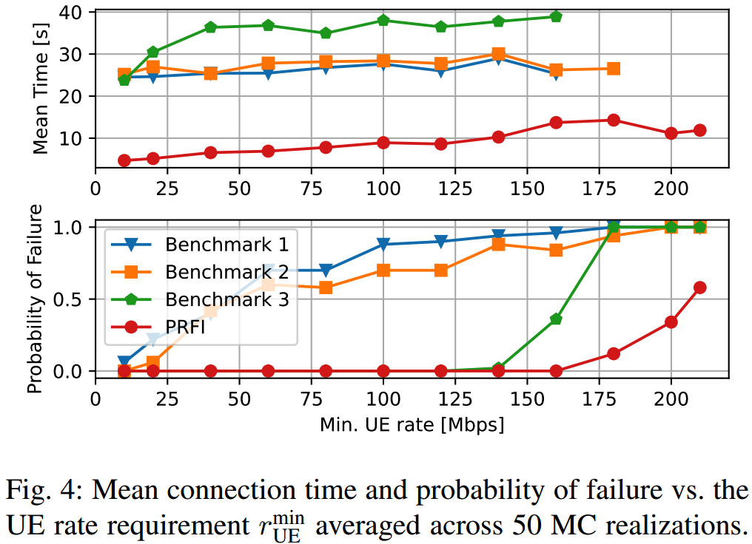
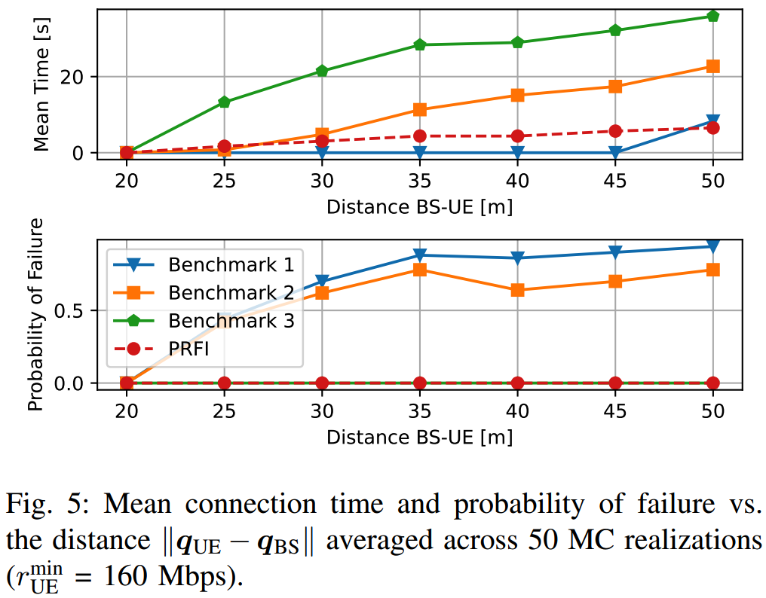
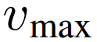
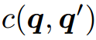
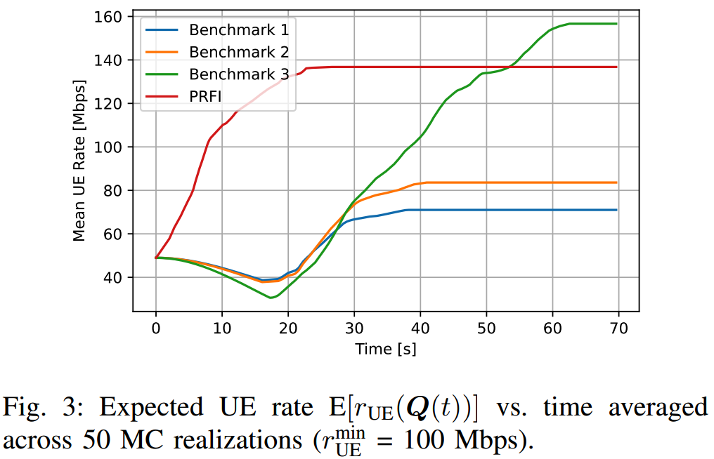
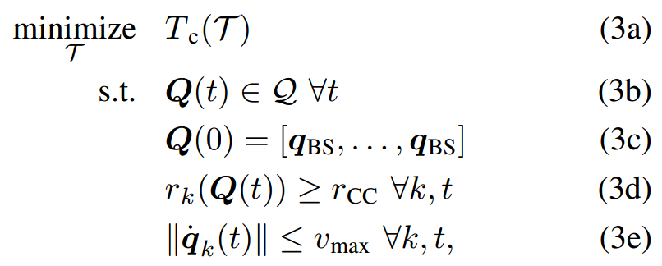


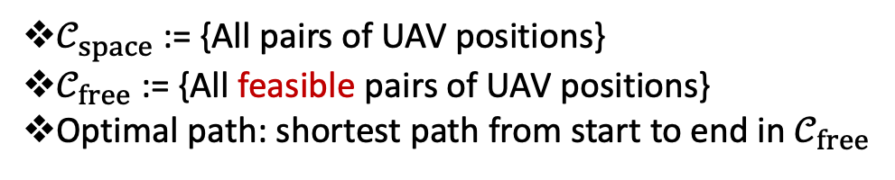
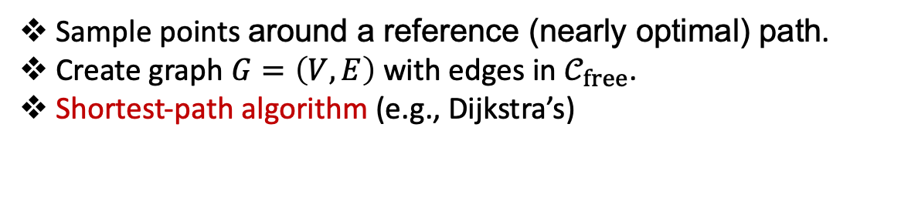


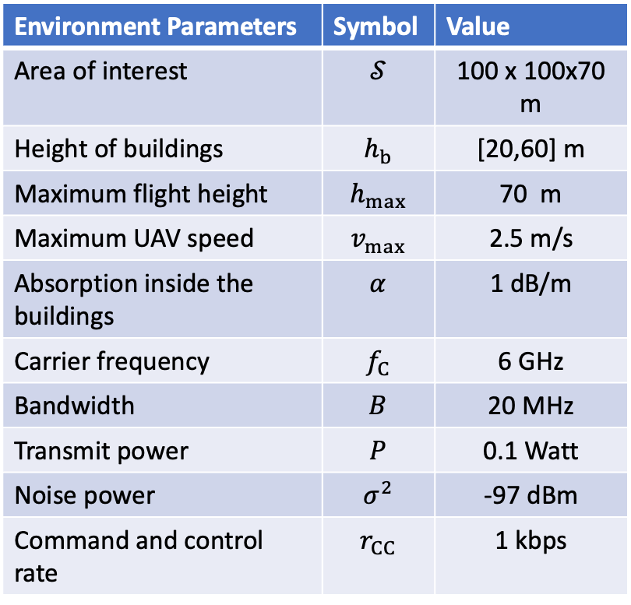

Probabilistic Roadmaps for Aerial Relay Path Planning
Pham Q. Viet and Daniel Romero
The Problem
Proposed Approach
Dept. of Information and Communication Technology, University of Agder, Grimstad, Norway
Goal: Plan the trajectory of two aerial relays (UAVs) to serve a user as fast as possible
Continuous function over time
Exact solution not generally possible
Find valid trajectory with reasonably
short connection time
Flight region discretization
Fly grid points
Prohibitive complexity!
Find conf. point sequence
through grid²
Shortest path?
[infme.com]
Curse of dimensionality
Planning in 6D
Probabilistic Roadmaps
Probabilistic Roadmaps with Reference Path
Base station
UAV-1
UAV-2
User
Work in context
end
end
end
Alternating optimization [Wang et al. 2018]
Genetic optimization [Anazawa et al. 2015]
Single UAV
Optimal path
Multiple UAVs
Non-linear optimization
[Zhang et al. 2018]
[Zhang et al. 2022]
Mixed-integer linear programs
[Ghazzai et al. 2018]
[Lee et al. 2022]
High complexity
Cannot accommodate
Obstacles, buildings
No-fly zones
start
start
start
Contribution: A path planning algorithm for aerial relays
Two UAVs
$𝒞_{space}$ := {All pairs of UAV positions}
$𝒞_{free}$ := {All feasible pairs of UAV positions}
Optimal path: shortest path from start to end in $𝒞_{free}$
Optimal
Plain vanilla
Optimal
Ref. path
Prob. Roadmaps with ref. path
Sample points in $𝒞_{free}$ at random.
Create graph $G=\left(V,E\right)$ with edges in $𝒞_{free}$.
Shortest-path algorithm (e.g., Dijkstra’s)
Sample points around a reference (nearly optimal) path.
Create graph $G=\left(V,E\right)$ with edges in $𝒞_{free}$.
Shortest-path algorithm (e.g., Dijkstra’s)
Approximately optimal
Low complexity
Can accommodate obstacles, buildings, no-fly zones…
Establishing Connectivity
Flight Region Discretization
1
Success is guaranteed!
Navigation phase
Command and control rate
Plan tentative paths
2
Base station
UAV-1
UAV-2
Plan path for UAV-2
Communication phase
Lift path of UAV-2
Infeasible
Plan path for UAV-1
UAV-1
UAV-2
Feasible
3
Sampling for probabilistic roadmap
Base station
User rate
User
Minimize
Connection time
Target user rate
4
Planning path in the configuration space
Location of UAV-k at time t
5
From the waypoint sequence to trajectory
Configuration point
Simulation Experiments
Problem Formulation
Given:
Position of a base station:
Target user rate:
Environment Parameters | Symbol | Value
Area of interest | $$𝒮$$ | 100 x 100x70 m
Height of buildings | $$h_{b}$$ | [20,60] m
Maximum flight height | $$h_{max}$$ | 70 m
Maximum UAV speed | $$v_{max}$$ | 2.5 m/s
Absorption inside the buildings | $$α$$ | 1 dB/m
Carrier frequency | $$f_{C}$$ | 6 GHz
Bandwidth | $$B$$ | 20 MHz
Transmit power | $$P$$ | 0.1 Watt
Noise power | $$σ^{2}$$ | -97 dBm
Command and control rate | $$r_{CC}$$ | 1 kbps
Position of a user:
Command and control rate:
Maximum UAV speed:
Channel map:
Optimization problem:
UAV-k’s rate
Challenge: high complexity
1

